Slide 1






How To Represent Data?

Slide 2

How Do we Collect Data?

Slide 3
DATA SOURCES
Primary: data collected by hand.
Secondary: data collected by others.
Examples:
https://www.kaggle.com
https://datasetsearch.research.google.com
https://archive.ics.uci.edu/datasets

Slide 4
Data Quality: Why Preprocess the Data
Measures for data quality:
Accuracy: correct or wrong, accurate or not.
Completeness: not recorded, unavailable.
Consistency: some modified but some not, dangling.
Timeliness: timely update?.
Believability: how trustable the data are correct.
Interpretability: how easily the data can be understood.

Slide 5
Preprocessing Tasks
Data Cleaning.
Fill in missing values, smooth noisy data, identify or remove outliers, and resolve inconsistencies.
Data Integration.
Integration of multiple datasets or files.
Data Reduction.
Dimensionality reduction.
Numerosity reduction.
Data Compression.
Data Transformation and Data Discretization.
Normalization.

Slide 6
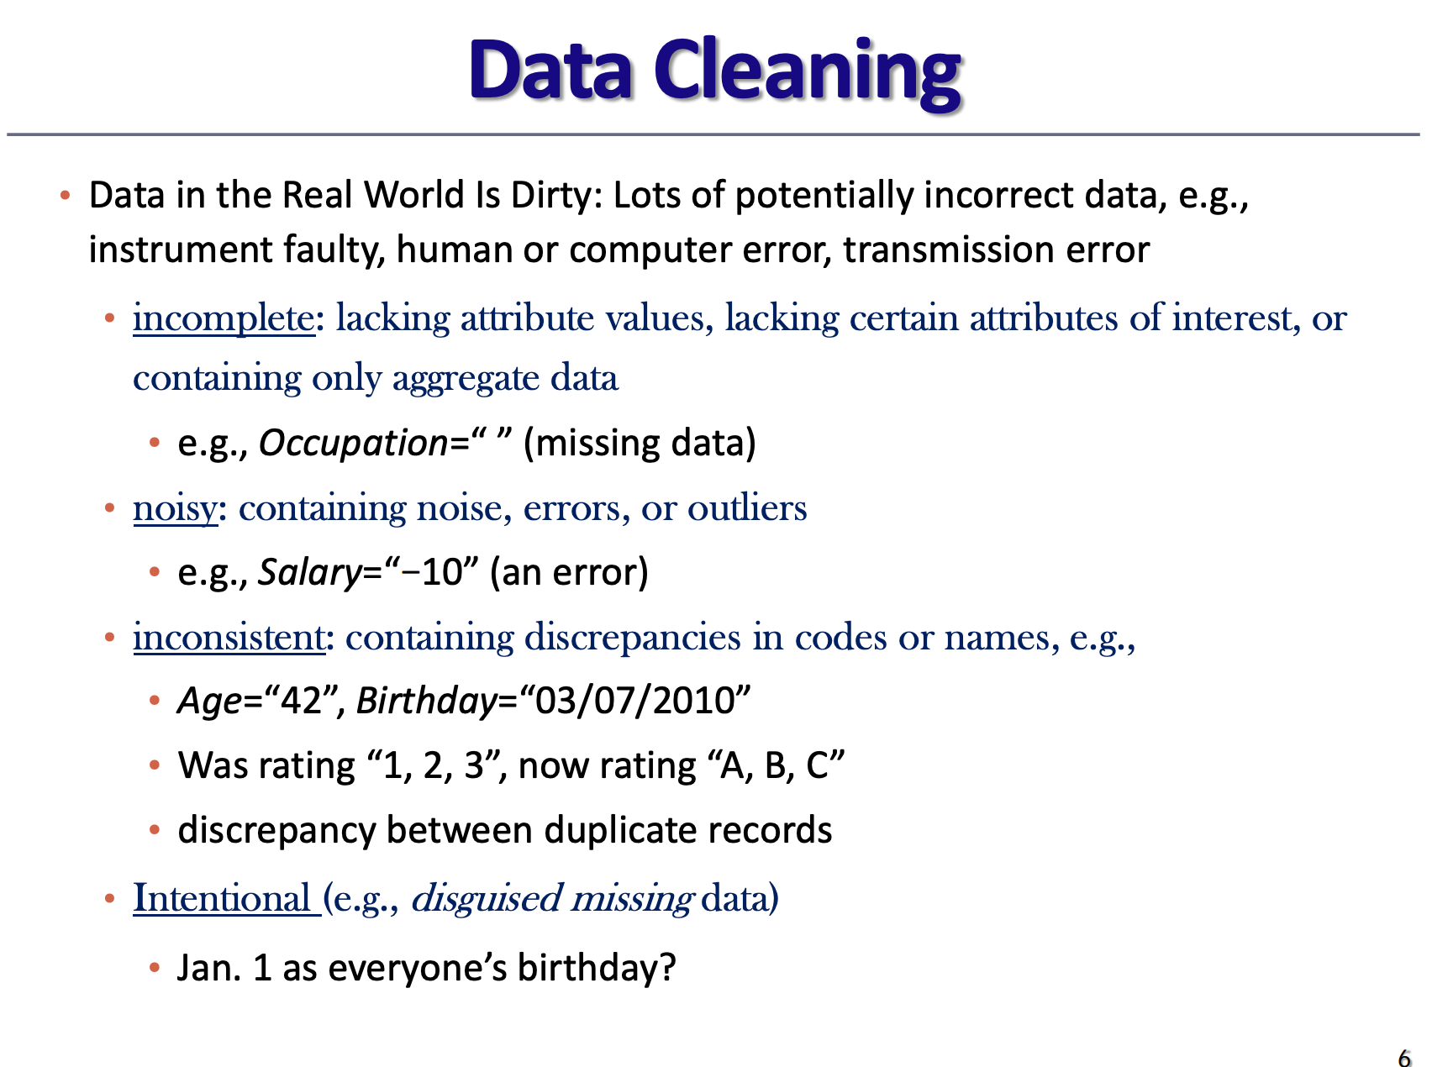

Slide 7
How To Represent Dataset?

Slide 8
DATASET
Features
label
Temperature | Humidity | Wind Speed | Weather
13 | 70 | 12 | Foggy
10 | 59 | 22 | Rainy
28 | 35 | 4 | Sunny
Instance
Notes:
in this slide show students how to represent data in case we have multiple inputs and multiple outputs.

Slide 9
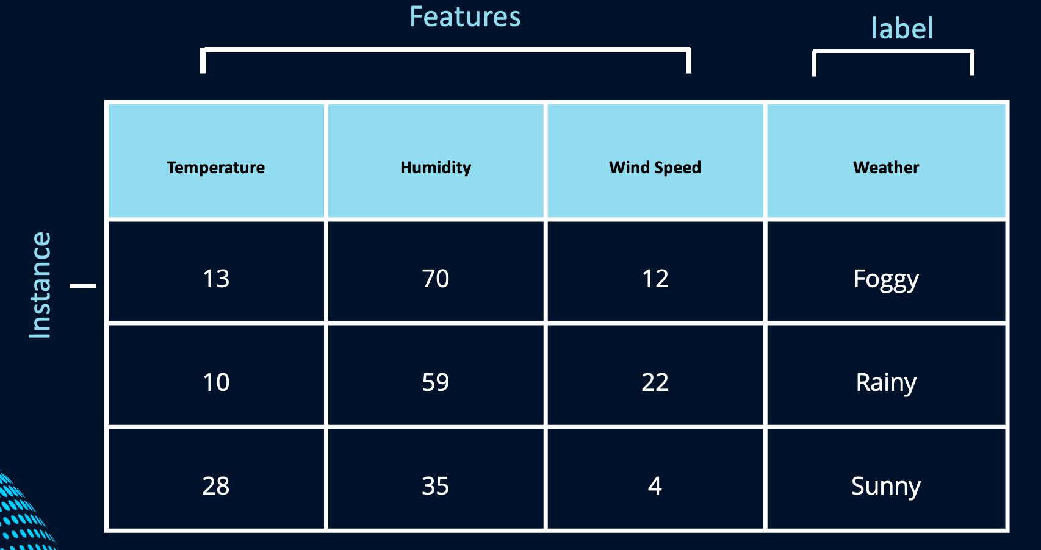
Basics
Feature: “an individual measurable property or characteristic of a phenomenon.”
Examples: height, weight, temperature, price, gender
Each feature can be thought of as a “dimension” of the problem
A feature vector is an n-dimensional vector of numerical features that represent some object
Instance 1 feature vector = [13,70,12] Label = Foggy
Instance 2 feature vector = [10,59,22] Label = Rainy

Slide 10
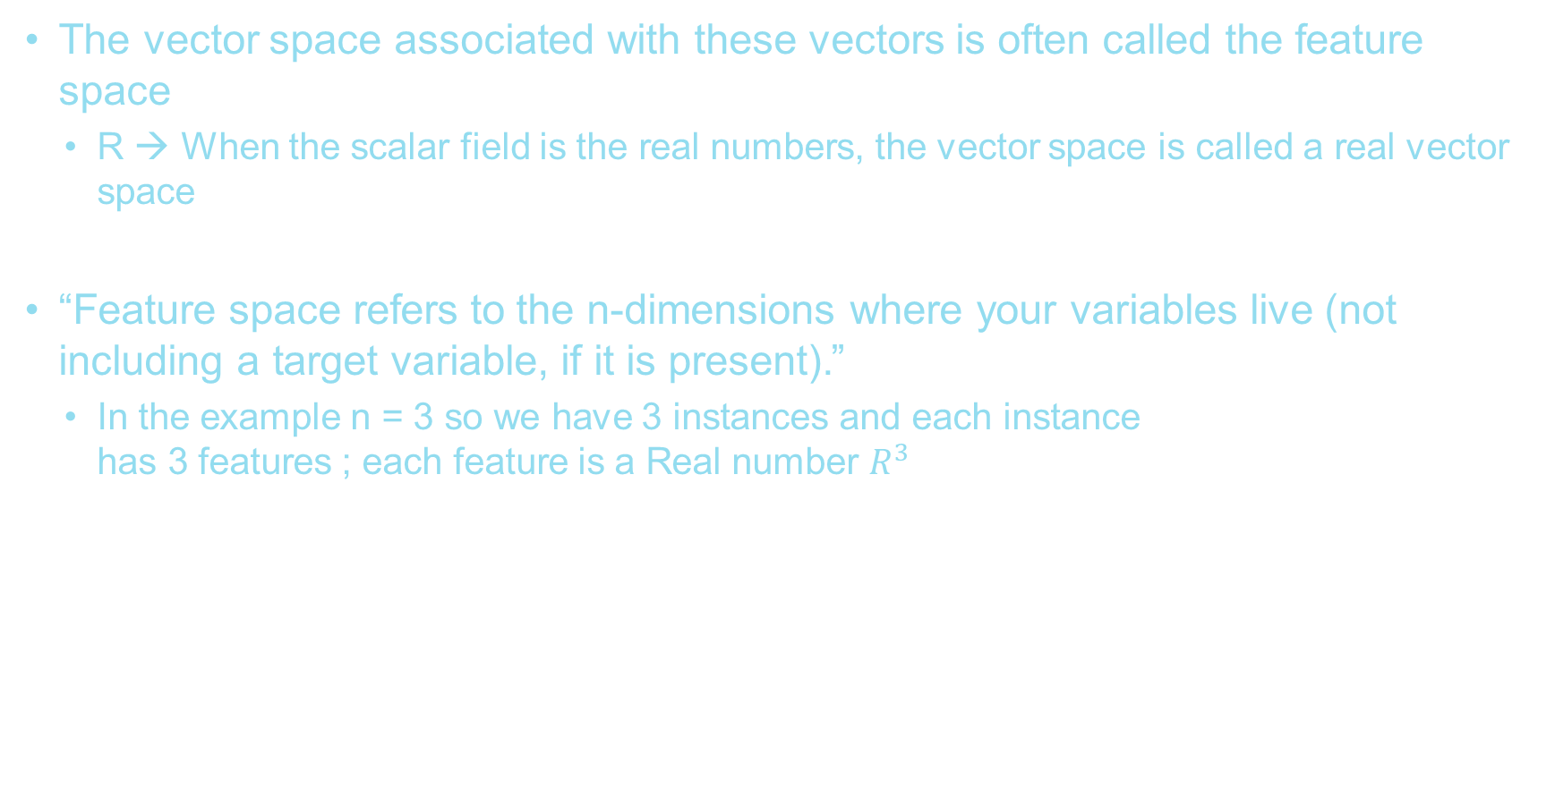
Basics
The vector space associated with these vectors is often called the feature space
R → When the scalar field is the real numbers, the vector space is called a real vector space
“Feature space refers to the n-dimensions where your variables live (not including a target variable, if it is present).”
In the example n = 3 so we have 3 instances and each instance has 3 features ; each feature is a Real number $R^{3}$

Slide 11
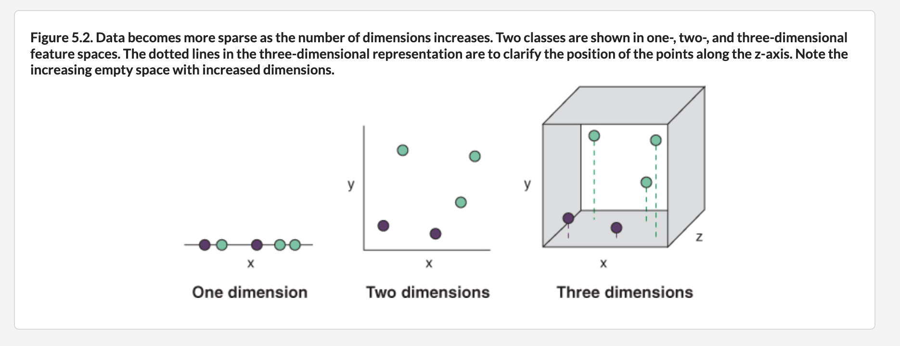

Slide 12
Humidity
Humidity
Wind speed
Temperature
Temperature
Temperature

Slide 13
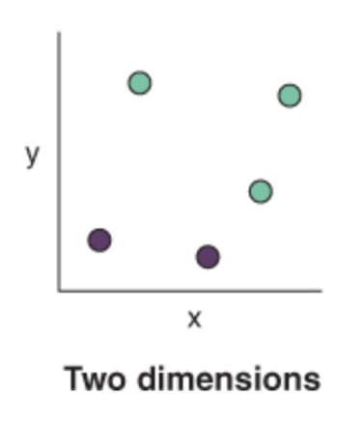
5 records / observation.
5 feature vectors.

Slide 14
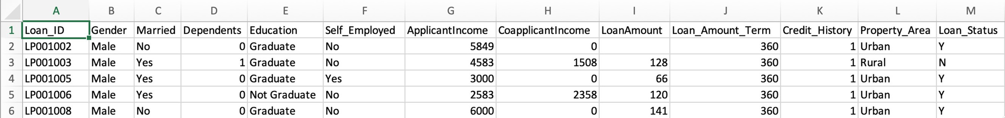
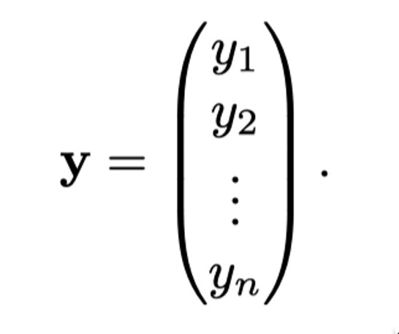
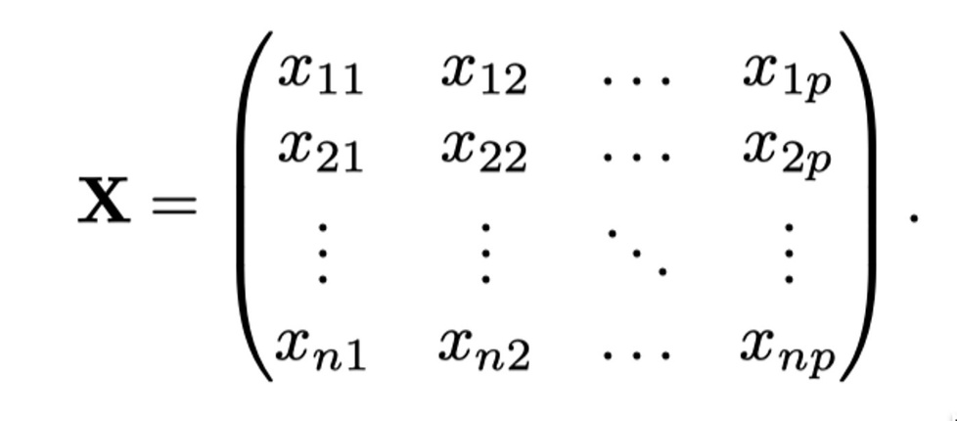
CREDIT APPROVAL EXAMPLE

Slide 15
TYPES OF FEATURES
Numerical Features: Continuous or discrete values (e.g., age, temperature, number of transactions).
Categorical Features: Qualitative values that represent distinct groups (e.g., gender, product type).
Ordinal Features: Categorical features with a meaningful order (e.g., education levels, customer ratings).
Text Features: Extracted from textual data using techniques like tokenization, TF-IDF, or word embeddings.
Image Features: Extracted using filters, edge detection, or deep learning models like CNNs.

Slide 16
OPERATIONS ON FEATURES
Feature selection: Choosing the most relevant features.
Feature extraction: Transforming raw data into useful features.
Feature scaling: Normalizing or standardizing numerical features.
Dimensionality reduction: Reducing the number of features while preserving essential information (e.g., PCA, t-SNE).

Slide 17
FEATURE SELECTION
Process that chooses an optimal subset of features according to a certain criterion.
Reasons:
remove irrelevant data.
reduce the complexity of AI models.
Can be considered a search problem.

Slide 18
SEARCH DIRECTION
Sequential Forward Generation (SFG):
start with empty set of features.
add features based on some criterion.
stopping criteria can be a threshold of number of relevant features.
Sequential Backward Generation (SBG):
start with the full set of features.
remove features one at a time.
stopping criteria can be a threshold of number of relevant features.
Bidirectional Generation (BG):
begin search in both direction.
stops when one search find the best subset of features or both searches achieve the middle of the search space.
Notes:
at the end of feature selection only a subset composed of a unique features, which is considered to be the most information of the whole set.

Slide 19
FEATURE EXTRACTION
Finding new features that are calculated as a function of the original features.
Ex: Stock data.
Notes:
calculate low, high, of stocks prices each day from raw data.

Slide 20
EXERCISE
Find 3 datasets on Kaggle, then prepare a report that includes the following:
Description about the dataset purpose.
The included features.
The label.
How is the problem related to AI?
Are the datasets balanced?
Do the datasets have missing values?
What are the feature types (categorical, numerical, text, image)?

Slide 21
References
Negnevitsky M. Artificial Intelligence: A Guide to Intelligent Systems.
Garcia S., Luengo J., and Herrera F. Data Preprocessing in Data Mining.
https://www.ibm.com/topics/natural-language-processing
https://web.cs.ucla.edu/~yzsun/classes/2013Spring_CS6220/slides/03Preprocessing.pdf?utm_source=chatgpt.com
https://en.wikipedia.org/wiki/Feature_(machine_learning)
https://dataorigami.net/2014/06/06/Feature-Space-in-Machine-Learning.html#:~:text=Feature%20space%20refers%20to%20the,Target
https://livebook.manning.com/concept/r/feature-space
https://www.kaggle.com/code/hafidhfikri/loan-approval-prediction/input

